Slide 1
GUIs Part 4
CS221 – 4/17/09

Slide 2
Professional Assignments
Assignment #2 – Download and install Visual Studio 2008 Professional Trial Software
http://www.microsoft.com/downloads/details.aspx?FamilyID=83c3a1ec-ed72-4a79-8961-25635db0192b&displaylang=en
Assignment #3 – Implement any one of your sorting algorithms using C# instead of Java
To get credit for both assignments:
Send me your working C# project in email
If it compiles and works you’ll get full credit

Slide 3
What we’ll cover today
Quick Review
Java Class Library
Packages
More SWING Programming

Slide 4
Java Class Library
Java includes over 3000 classes for your use!
Almost entirely written in Java
These classes help with a variety of common tasks
Managing lists of objects
String parsing
GUI programming
You access through the use of classes grouped by packages

Slide 5
Packages
Classes are grouped together with packages
Why packages?
Provides hierarchical organization to classes
Solves the problem of class name collision
All java packages start with java or javax
3rd party developers (like you) can create other package names

Slide 6
Example Packages
Java.lang – fundamental classes to the language, e.g. string, process, thread, etc
Java.io – data streams, serialization and file system
Java.net – support for building networking applications
Java.awt – basic GUI support
Javax.swing – built on awt adds more GUI features
Java.sql – access to SQL databases

Slide 7
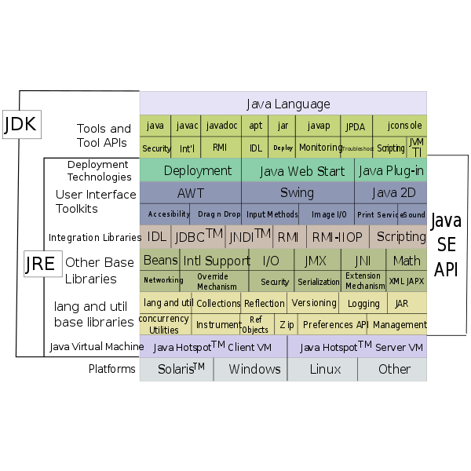
Many More

Slide 8
Using Packages
Import statement tells the compiler you want to use a class
E.g.: import java.awt.*
* symbol indicates you want to import all sub-packages within the java.awt package.
java.lang is special. Every java program automatically imports this package.

Slide 9
Using Packages
You can reference a class without the import
E.g. new java.awt.Color(0,0,0);
Not recommended, using import is better for:
Readability
Makes it easy to understand what classes your program depends upon
Under what condition would you want to reference a class without an import statement?
Notes:
Java.awt.list
Java.util.list

Slide 10
Class Methods
Constructor
Used to manufacture new instances of a class
Instance
Associated with a specific instance of an object
Object must be instantiated (created) for an instance method to be called
Static
Applied to a class as a whole, rather than to an instance
Can be called without instantiating the class

Slide 11
Examples
Constructor
Declaration:
public Math()
Usage:
Math math = new Math();
Instance
Declaration:
public int abs(int x)
Usage:
Math math = new Math();
math.abs(-5);
Static
Declaration:
public static int abs(int x)
Usage:
Math.abs(-5);

Slide 12
Constants
Constants are variables whose values cannot change
Many classes define constants
These are declared as:
Static, value is associated with the class
Final, value cannot change
For example the Color class defines
static final Color BLACK

Slide 13
Constants
Use class defined constants to improve readability
setFillColor(Color.RED)
area = Math.PI * radius * radius
How to declare your own constants
Use all caps
PI, BLACK, RED, etc.
Use underscores if necessary
NUMBER_OF_MONTHS
Assign value at declaration
public static final float PI = (float) 22/7;

Slide 14
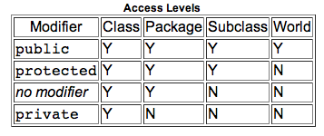
Variable and Method Access

Slide 15


Back to SWING
Let’s turn this:
Into this:

Slide 16
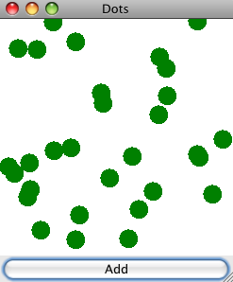
Let’s see how to do this

Slide 17
Problems
How to draw freely on the screen?
Extend JComponent
paintComponent(Graphics g)
How to randomly place a circle in our component
Math.random()
getWidth, getHeight

Slide 18
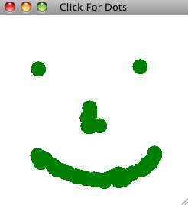
Let’s make it better

Slide 19
Problems
How to capture mouse events?
Implements MouseListener
addMouseListener
mousePressed(MouseEvent e)

Slide 20
Think About
How would we:
Keep drawing circles as long as the mouse is clicked?
Allow the user to select a circle and drag it somewhere else?
What can we use to figure it out?

Slide 21


